Slide 1
This Is Their Life: Reptiles!

Slide 3
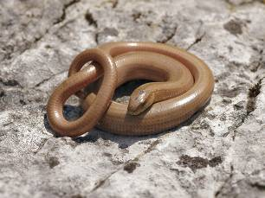
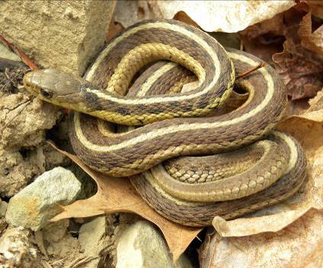
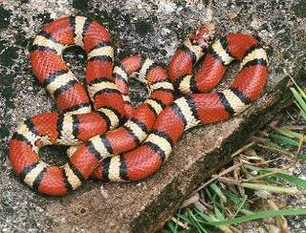
This Is Their Life: Reptiles!
Snakes

Slide 4
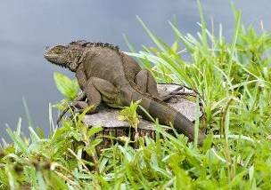
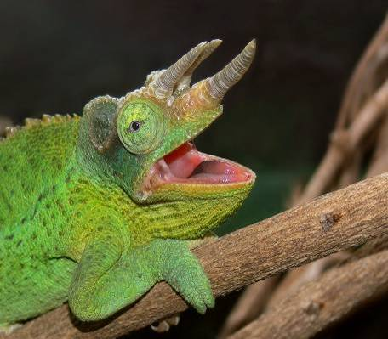
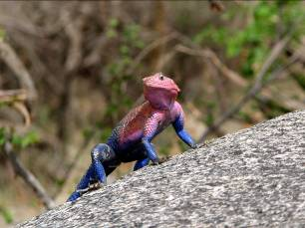
This Is Their Life: Reptiles!
Lizards

Slide 5
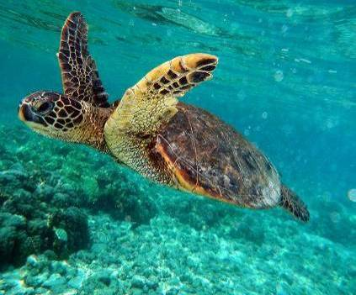
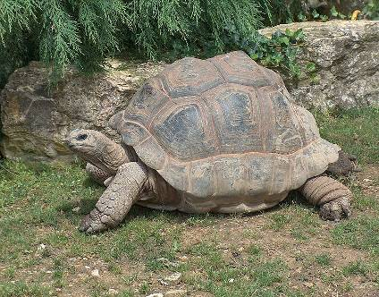
This Is Their Life: Reptiles!
Turtles and Tortoises

Slide 6
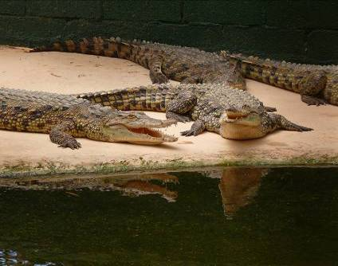
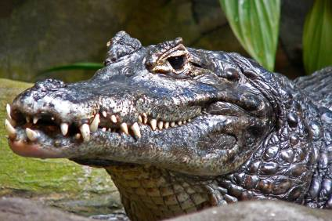
This Is Their Life: Reptiles!
Crocodilians

Slide 7
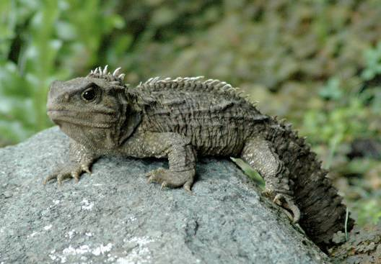
This Is Their Life: Reptiles!
Tuataras

Slide 9
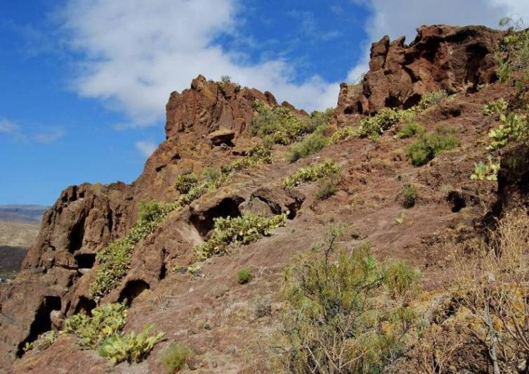
This Is Their Life: Reptiles!

Slide 10
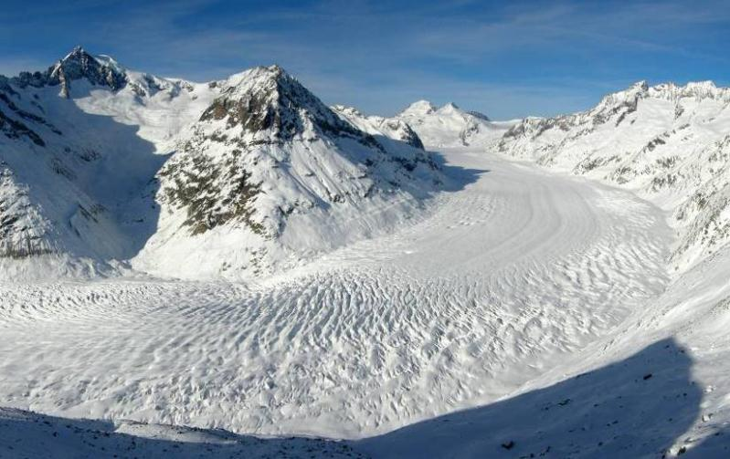
This Is Their Life: Reptiles!

Slide 12
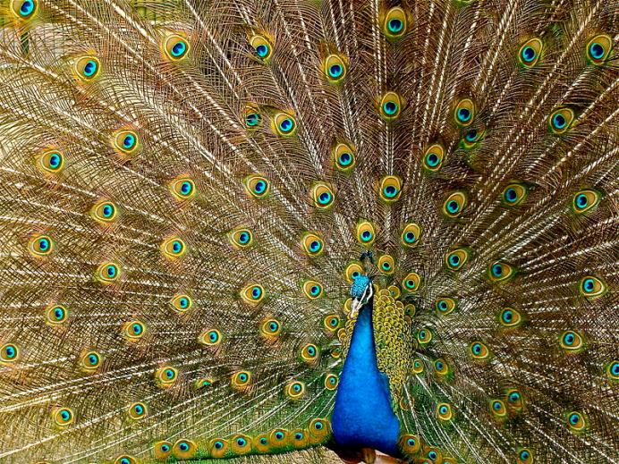
This Is Their Life: Reptiles!

Slide 13
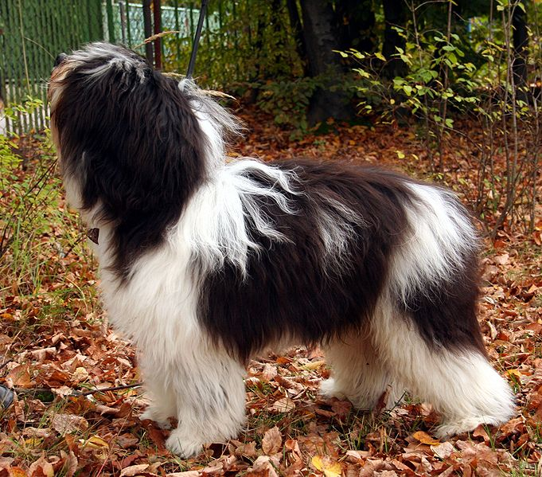
This Is Their Life: Reptiles!

Slide 14
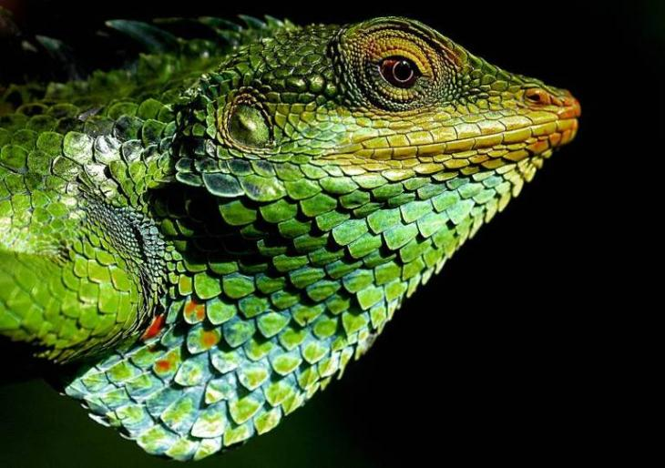
This Is Their Life: Reptiles!

Slide 16
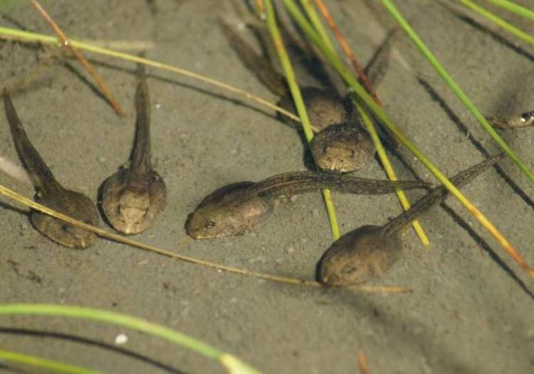
This Is Their Life: Reptiles!

Slide 17
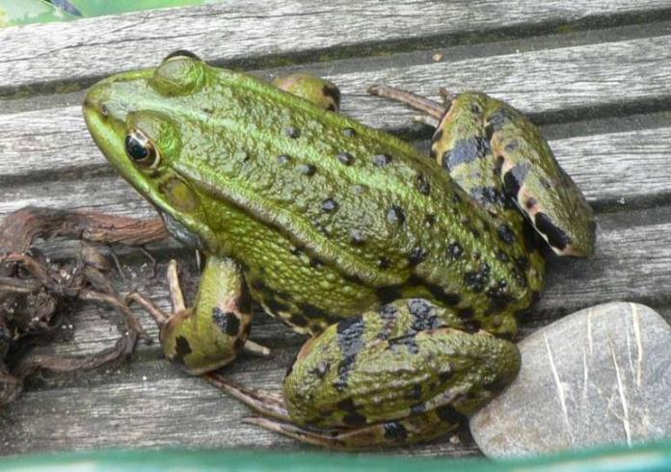
This Is Their Life: Reptiles!

Slide 19
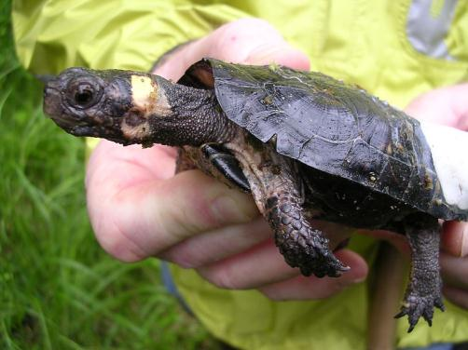
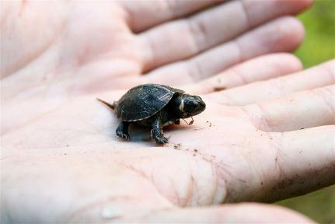
This Is Their Life: Reptiles!

Slide 21
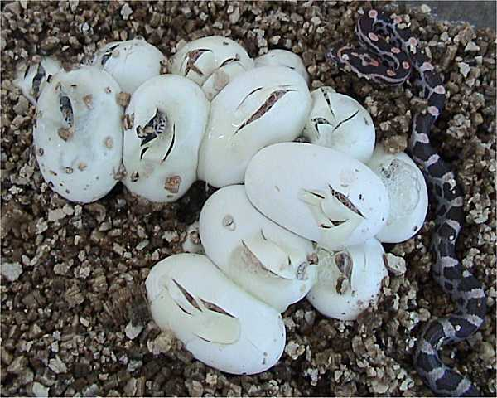
This Is Their Life: Reptiles!

Slide 22
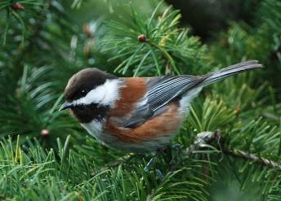
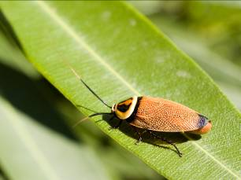
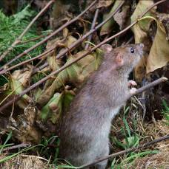
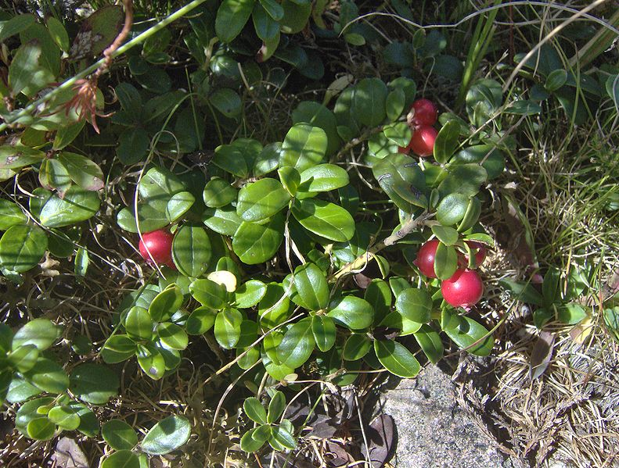
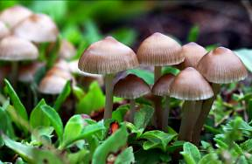
This Is Their Life: Reptiles!

Slide 23
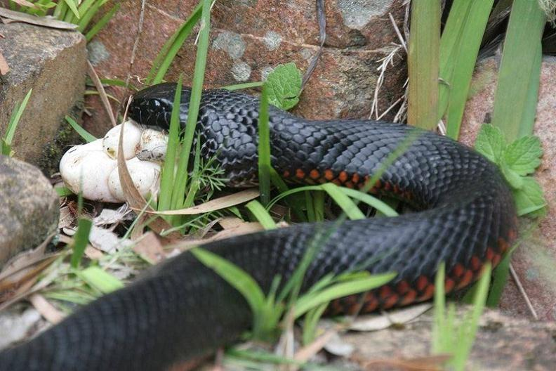
This Is Their Life: Reptiles!

Slide 24
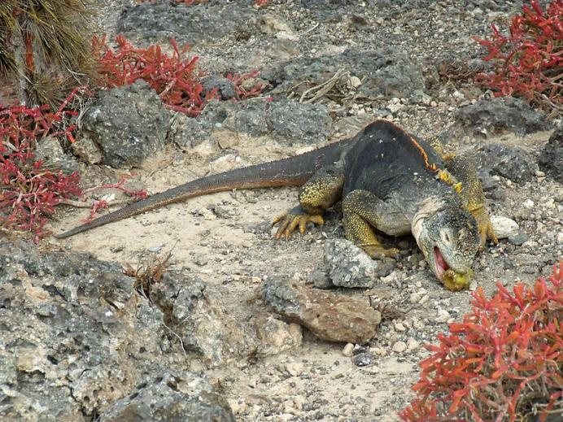
This Is Their Life: Reptiles!

Slide 26
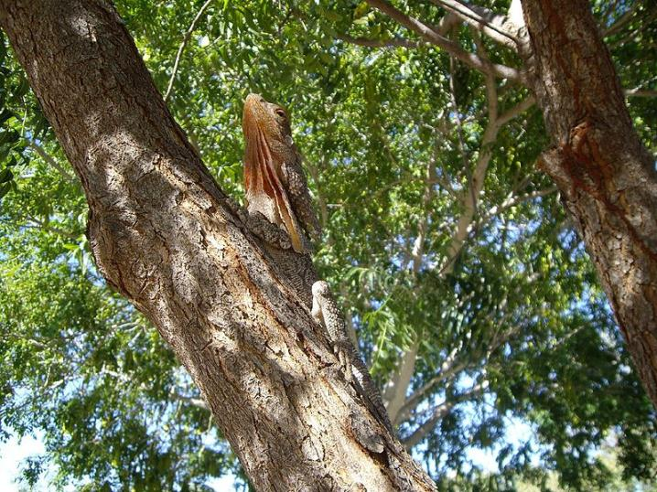
This Is Their Life: Reptiles!

Slide 27
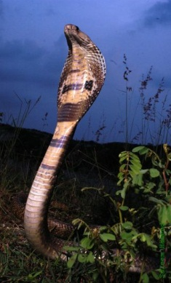
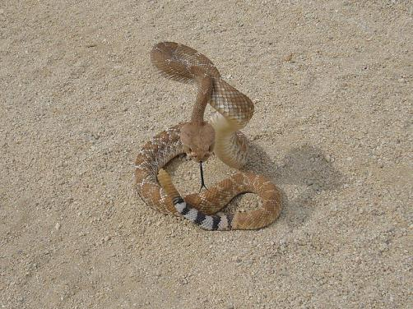
This Is Their Life: Reptiles!

Slide 28
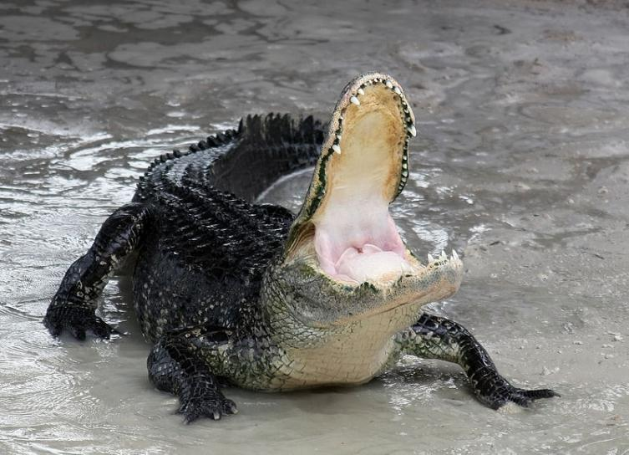
This Is Their Life: Reptiles!

Slide 29
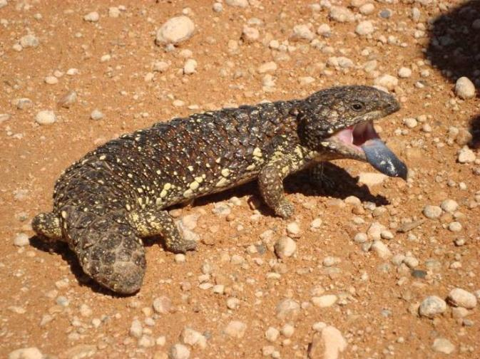
This Is Their Life: Reptiles!

Slide 31
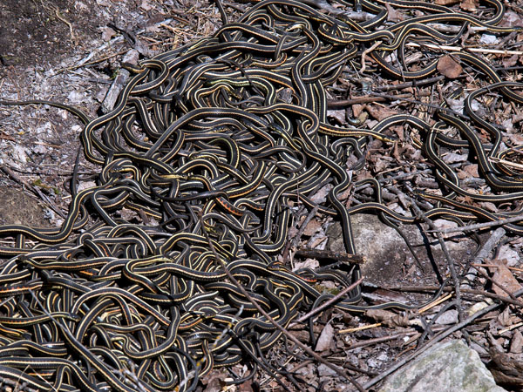
This Is Their Life: Reptiles!

Slide 32
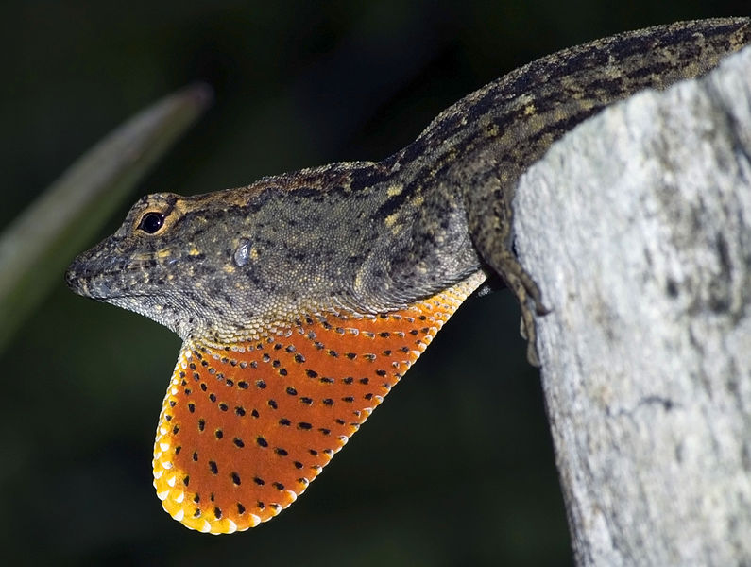
This Is Their Life: Reptiles!

Slide 34
All photos in the public domain except as follows:
Used under a Creative Commons Attribution Share-Alike 3.0 license:
“Tuatara” by KaresH
“Aletschgletscher-Eggishorn” (Aletsch glacier, Switzerland) by Tobias Alt
“Paonroue” (peacock) by Jebulon
“Polski owczarek nizinny” (Polish lowland sheepdog) by Pleple 2000
“Large-scaled forest lizard” by Babujayan
“Corn snake eggs hatching” by LA Dawson
“American alligator defensive” by lanaré Sevi
“Anolis sagrei male dewlap” by lanaré
Used under a Creative Commons Attribution Share-Alike 2.0 license:
“Frill-necked lizard (Chlamydosaurus kingii) camouflaged within its
natural environment” by Happy Little Nomad
Thanks to all contributors, editors and proprietors of Wikimedia Commons

