Slide 1
What Makes a “Bug?”

Slide 2
Notes:
We’re going to be talking about the life cycles of arthropods today. But first, we have to figure out what animals we’re talking about. So, here are the five main groups of animals scientists call arthropods:

Slide 3
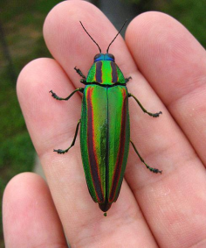
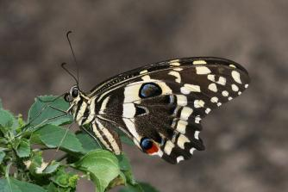
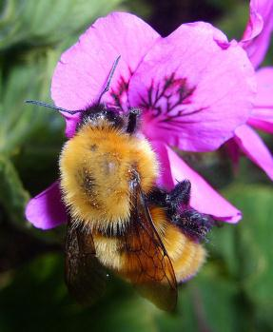
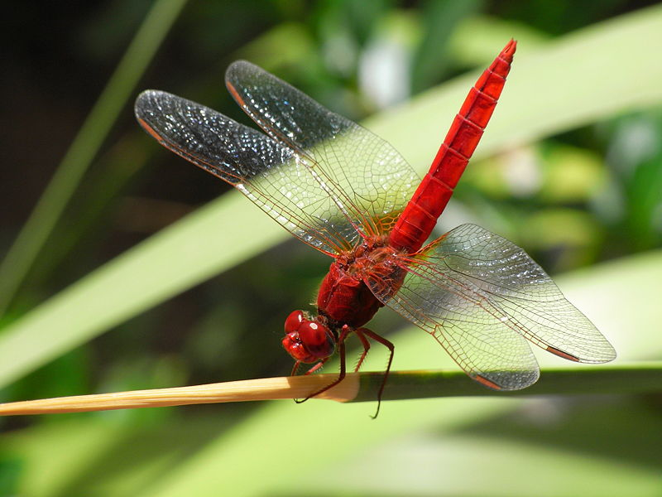
What Makes a “Bug?”
Insects

Slide 4
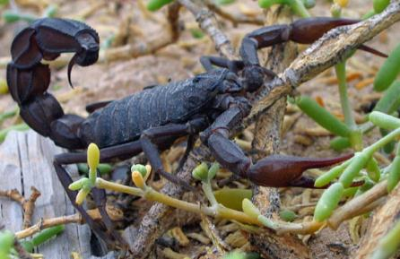
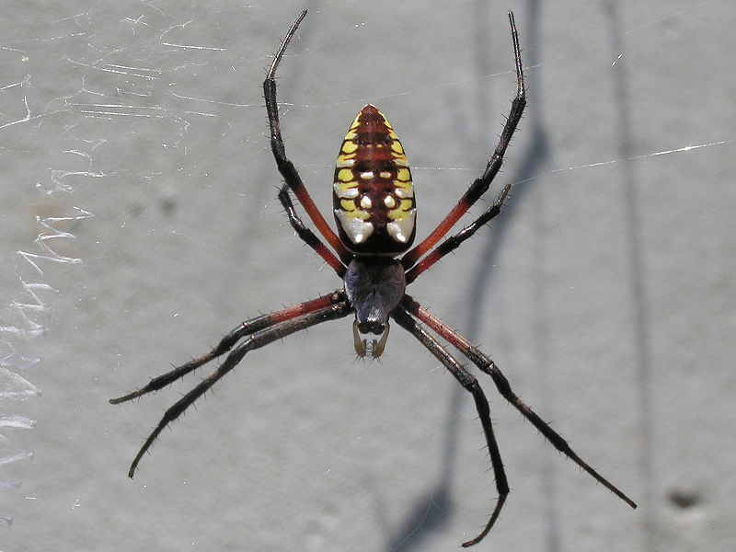
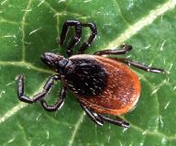
What Makes a “Bug?”
Arachnids

Slide 5
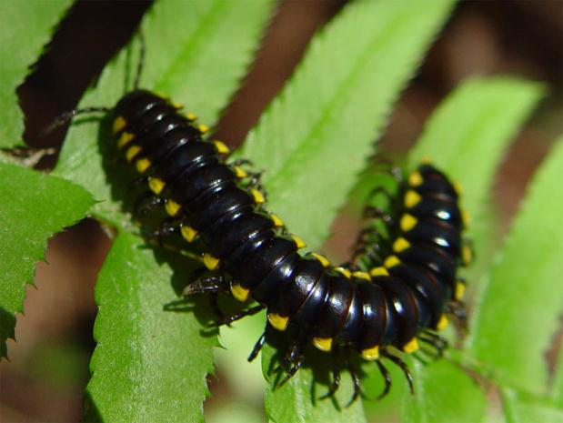
What Makes a “Bug?”
Millipedes

Slide 6
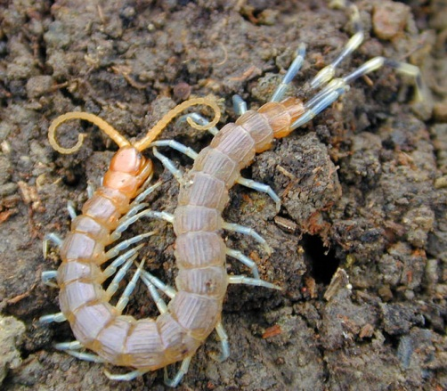
What Makes a “Bug?”
Centipedes

Slide 7
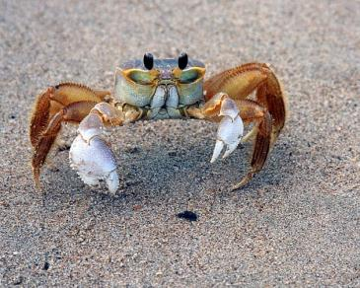
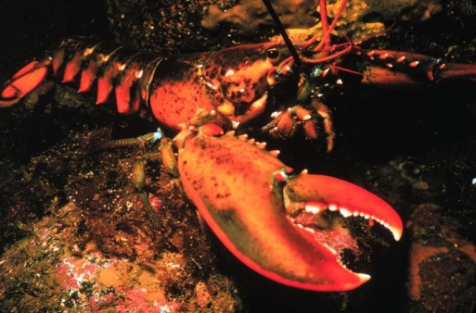
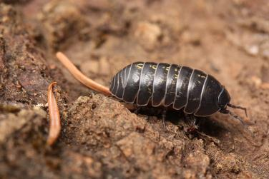
What Makes a “Bug?”
Crustaceans

Slide 8
Notes:
Now we know what animals are arthropods, but we still need to know why each of these groups are classified as that. So, here are the three main characteristics that make an animal an arthropod:

Slide 9
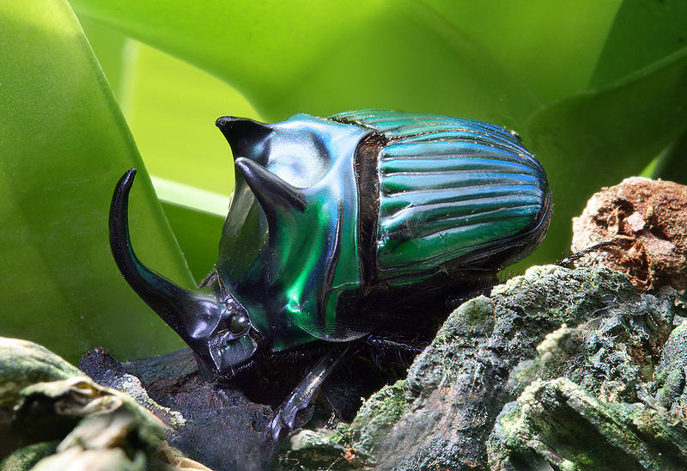
What Makes a “Bug?”
First:
An exoskeleton
Notes:
An arthropod doesn’t have bones on the inside of its body like you and I. Instead, it has a hard outer shell called an exoskeleton. It gives the animal shape and structure; provides places for muscles to attach; and can help protect the animal against predators. But, the exoskeleton is hard, so it can’t grow or stretch as the arthropod grows. Instead, the arthropod has to molt its exoskeleton as it grows.

Slide 10
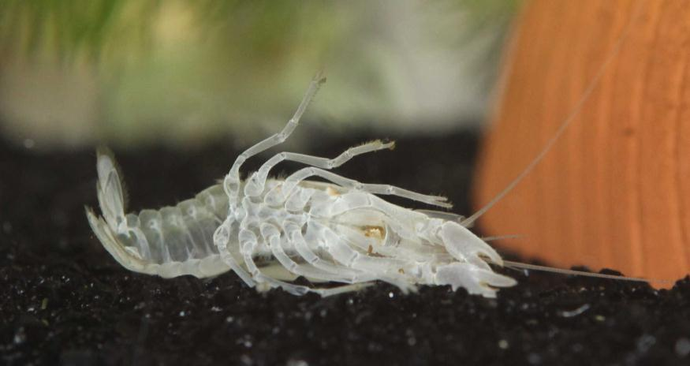
What Makes a “Bug?”
Notes:
This is the old, molted exoskeleton of a crayfish.

Slide 12
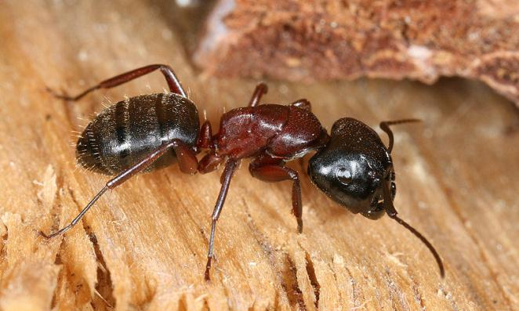
What Makes a “Bug?”
Second:
Segmented body
Notes:
This ant has very distinct body segments. All insects have three segments, the head, thorax, and abdomen. Other arthropods have different numbers of segments. (Some large millipedes may have more than 100!)

Slide 13
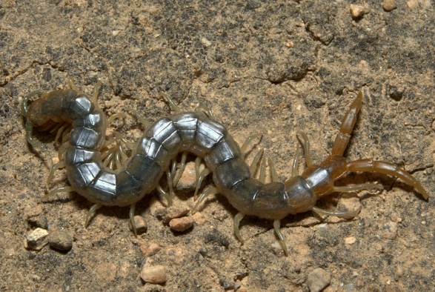
What Makes a “Bug?”
Notes:
Check out this Oman centipede – lots of segments, and you can see how the joints between the segments allow him to move.

Slide 15
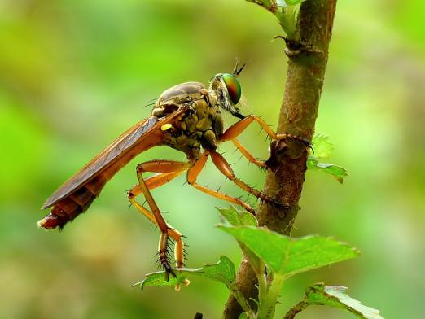
What Makes a “Bug?”
Third:
Jointed appendages
Notes:
An appendage is anything that sticks off the body or head of an animal, such as arms, legs, tails or antennae. This dragonfly has very sturdy-looking legs with plenty of joints.

Slide 16
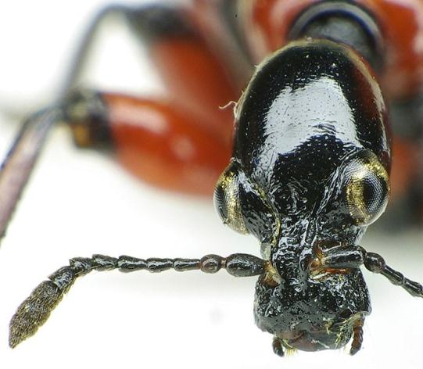
What Makes a “Bug?”
Notes:
Here’s an example of another jointed arthropod appendage: the head of a European beetle. Note the joints in the antenna!

Slide 18
All photos in the public domain except as follows:
Used under a Creative Commons Attribution Share-Alike 3.0 license:
“Black scorpion” by Dbenbenn
“Armadillidium vulgare 2418” (pillbug) by Walter Siegmund
“Centipede” by John Hill
“Oxysternon conspicillatum male” (rhinoceros beetle) by Richard Bartz
“Oman centipede” by Moayed Bahajjaj
“Harpaphe haydeniana” (cyanide-producing millipede) by Franco Folini
“Apoderus coryli head front” by Siga
Thanks to all contributors, editors and proprietors of Wikimedia Commons

